Slide 1

DEPARTMENT OF COMPUTER SCIENCE Project Presentation (KCS 851) Enterprise Resource Planning
Guide Name
Ms. Neha Shukla (Assistant Professor)
Project Members Name
Avinash Kumar (2000290120050) 8 A
Varun Kumar Tiwari (2000290120186) 8 C

Slide 2
CONTENT
Problem Statement
Objectives
Technology Used
Literature Survey
Diagrams
Project Status
Implementation Details
All Documents Proof
References

Slide 3
Problem Statement
Examination Cell was facing issue in the generation of Datesheet ,Seating Plan, Invigilation Duty Chart and Attendance .
They had to do a lot of manual work before the conduction of every examination.
They had to prepare different type reports for sending the information to student and faculty.
They had to prepare list of attendance manually to send the respective HOD’s and higher authority.
The management of data was also a difficult task for them, So they provided us the idea to implement the process of examination.
We gathered the complete information from them regarding the process of examination and analyzed the requirement before implementation.

Slide 4
Objectives
Generation of Datesheet.
Generation of Seating Plan.
Generation of Invigilation Duty Chart.
Attendance of students appearing for examination.
Different types of reports.

Slide 5
Technology Used
Front end
AngularJS, React JS, HTML, CSS, JavaScript
Backend
Django, Python, MySQL (Database)

Slide 6
Literature Survey
Paper Title | Author Name | Journal Name | Year of Publishing | Summary
Automation of Exam Hall Allotment and Seating Arrangement | Shazia Anjum , Madhuri Devi Chodey , Muneeb Afzal C | International Journal of Engineering Research and Technology | 2021 | This challenge allows in the technology of stories of seat preparations made and helps in producing random order of precise path or segment exams in every week.
Automated Supervision Allocation System | Prof. S. S. Aravinth | International journal of Innovative research and technology | 2014 | The paper most important goal for developing this software program is to computerize the traditional way of carrying out exams

Slide 7
Paper Title | Author Name | Journal | Year of Publishing | Summary
Automatic Seating Arrangement of University | Dinesh Chandewar, Mainka Saha | International Journal of Science Technology and Engineering | 2017 | The paper is to lessen the significant mission of manually allocating seats at some point of an exam. The device will provide an effective measure to dynamically allocate students in a lecture room
Examination Hall and Seating Arrangement Application using PHP | R.Gokila, Antony Rohan Das | International journal of engineering science and computing | 2018 | The paper describes system is evolved to generate the examination corridor seating arrangement for students efficaciously. The advanced machine is helpful for each group of workers and college students
Examination Management Automation System | Vamsi Krishna Yepuri | International Research Journal of Engineering and Technology | 2018 | This paper provides a comparative look at on various techniques and device that exists and is being used broadly.

Slide 8
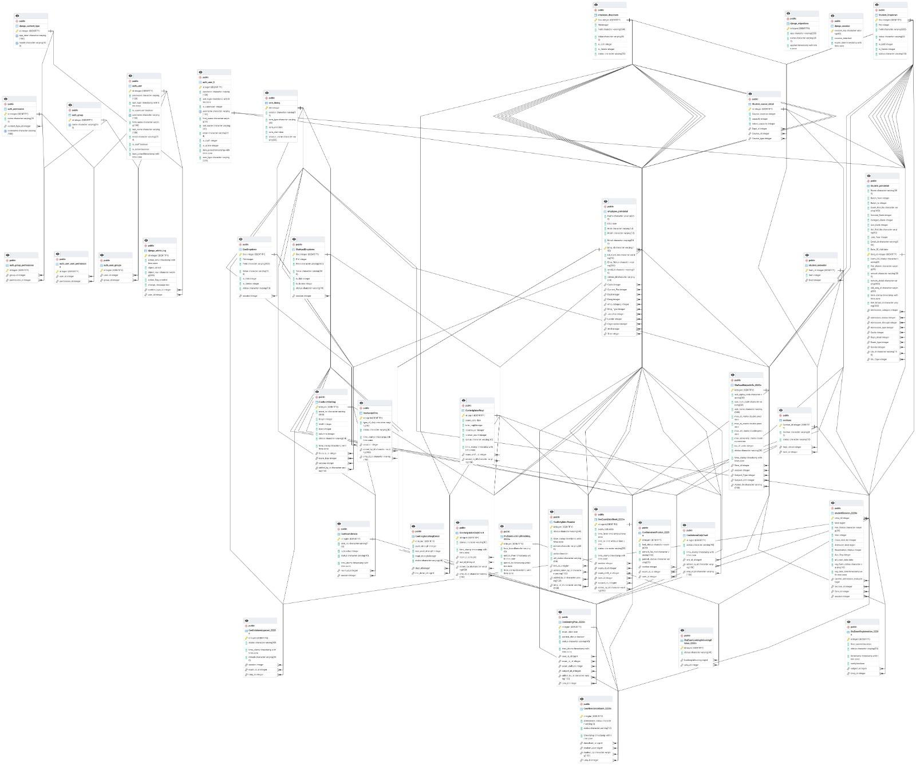
ER Diagram

Slide 9
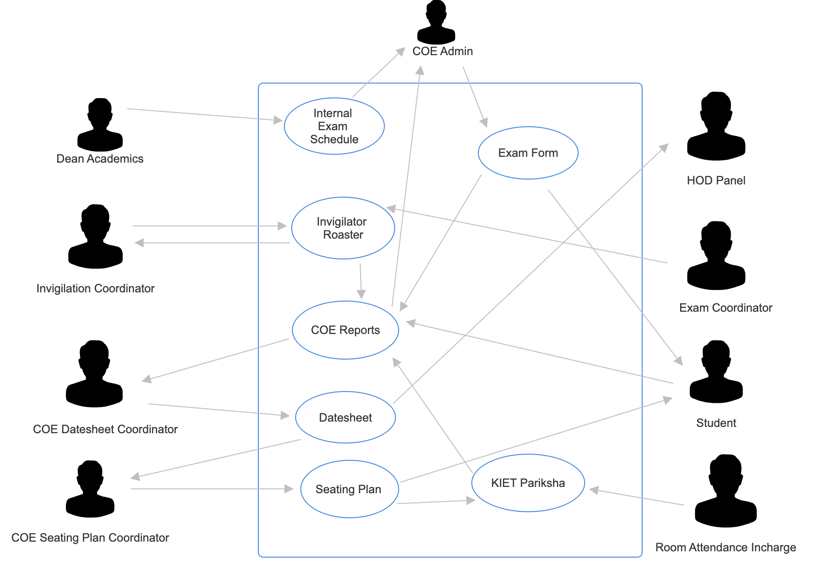
Use Case Diagram

Slide 10
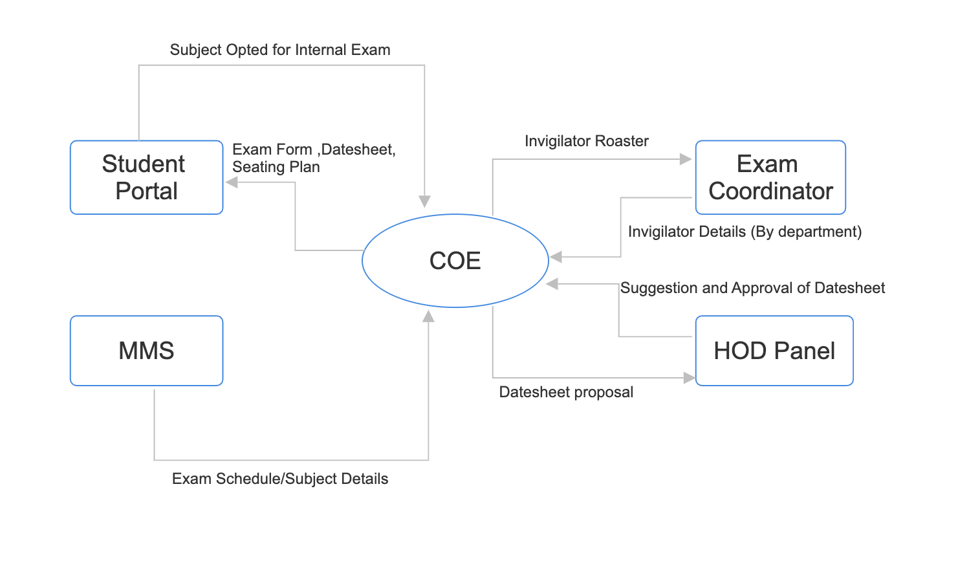
Data Flow Diagram

Slide 11
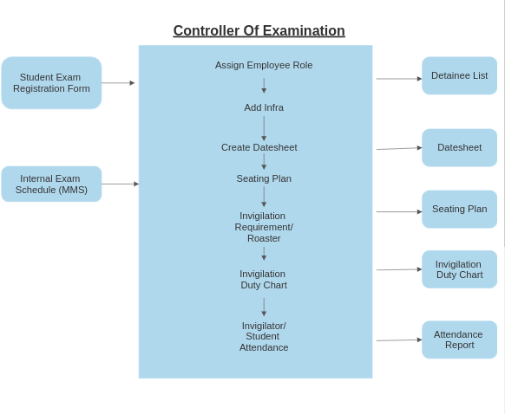
Process Work Flow Diagram

Slide 12
Project Status
This module has been approximately 95% developed, and all the completed portions have undergone thorough testing using various real-time test cases. The components comprising the Datesheet, Seating Plan, Invigilation Duty Chart, as well as student and faculty attendance, have been successfully developed and rigorously tested. Over the past two semesters, our college's examination team has utilized this module for conducting all examinations.
Additionally, discussions are underway for new requirements, and work is currently in progress for their implementation.

Slide 13
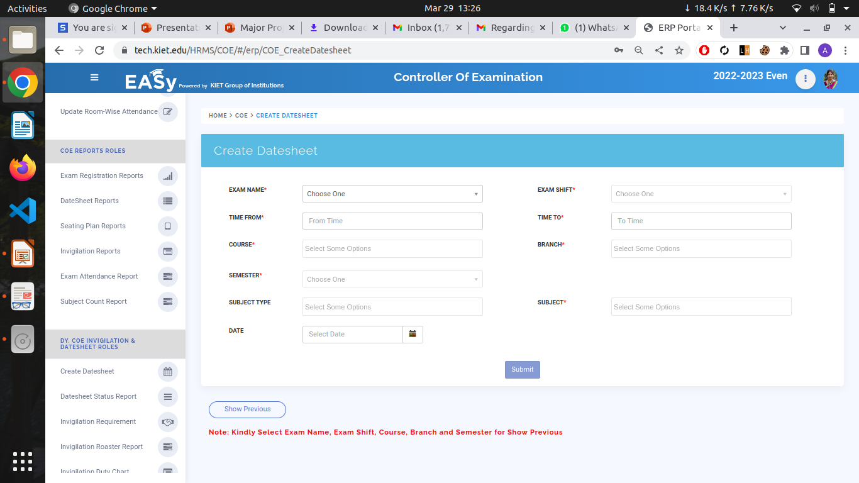
Implementaion

Slide 14
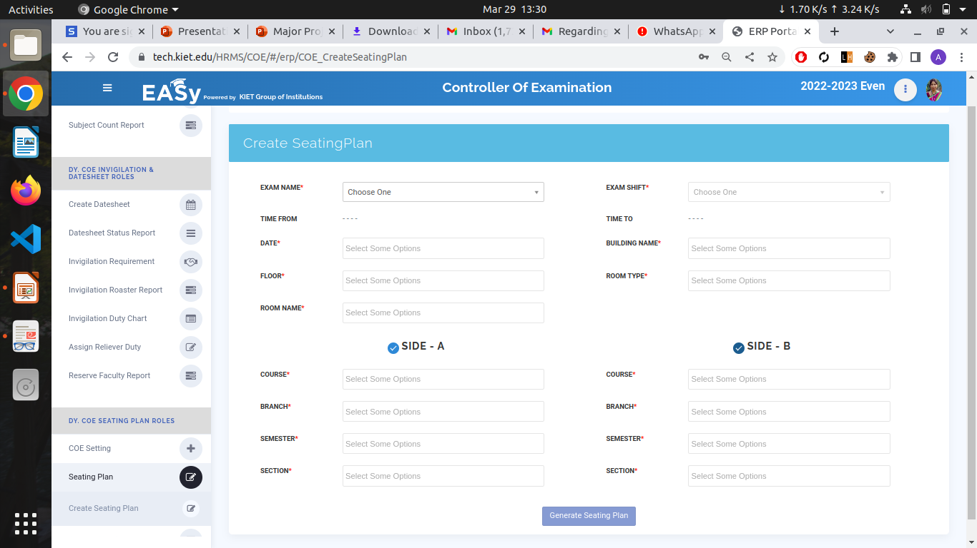

Slide 15
All documents Proofs (Github and Drive)
Testing Report
Synopsis
Report

Slide 16
References
[1] Prof. S. S. Aravinth, “Exam Hall Seating Arrangement System”
[2] Prof . Gautami G. Shingan, “Automated Supervision Allocation System”
[3] Dinesh Chandewar, Mainka Saha ,“Automatic Seating Arrangement of University”
[4] R.Gokila, Antony Rohan Das, “Examination Hall and Seating Arrangement Application using PHP”
[5] R.Chandrasekr, “Automation of Hall Seating Arrangement System”
[6] Vamsi Krishna Yepur , “Examination Management Automation System”
[7] Shazia Anjum, Madhuri , “Automation of Exam Hall Allotment and Seating
Arrangement”

